Slide 1
E-Medicare Group-1
JAVA MICROSERVICES

Slide 2
TEAM MEMBERS
James X - 2563543
Julakanti Nikhitha - 2563732
Manas Ranjan Acharya - 2564083
Nivetha Parthasarathy - 2563006
Pratik Tanaji Patil - 2563515
Rutuja Sanjay Kakuste - 2563145
Akula Manasa - 2564552
Garimella Sai Supraja - 2563954
Jyoti Ganapati Devadiga - 2564237
Silpa S Pillai - 2563024

Slide 3
CONTENTS
Introduction
Background
Technologies Used
Microservice Architecture
Services
Config Server
Eureka Server
Feign
Resilience4j
Retry
Sleuth
Zipkin
Output
Conclusion

Slide 4
INTRODUCTION OF E-MEDICARE
E-Medicare is a comprehensive healthcare and medical services platform designed to improve and streamline healthcare delivery, enhance patient experiences, and make healthcare more accessible and efficient.
This digital healthcare solution leverages technology to address various aspects of the healthcare ecosystem, benefiting patients, healthcare providers, and stakeholders in the healthcare industry.

Slide 5
Background of the Project
Medicare is a healthcare company established in 2012, specializing in supplying medicines and healthcare essentials at an affordable price.
Medicare's team is responding by developing backend RESTful Web services using Java Microservice and Spring Cloud Architecture.
These services will support the frontend UI developed in AngularThe application will have two user roles: admin users and end users. Admins can manage product details, while end users can register, search for products, customize purchases, and complete seamless payments.
Key functionalities include admin account creation, product management (add, remove, edit, enable/disable), user registration and profile management, product search with filters and sorting, customized purchasing, and an order summary page post-payment.

Slide 6

Tools and Technologies
Server-side: Spring Boot, Spring Cloud, Spring Data JPA Database: MySQL Server: EmbeddedTomcat DevOps: Docker, Git Hub Spring Cloud: Spring Cloud Config, Spring Cloud Netflix Eureka, Feign, Resilience4j, Retry, Sleuth and Zipkin.

Slide 7
Microservices Architecture
Microservices is an approach to developing a single application as a suite of small services.
It allows large systems to be built up from a number of collaborating components.
It is like a game changer in application design, breaks down a complex system into smaller, independent services that can be developed, deployed and scaled individually.

Slide 8
E-MEDICARE SERVICES
ADMIN SERVICES
USER SERVICES
MEDICINE SERVICES
ORDER SERVICES
PAYMENT SERVICES

Slide 9
User Management: Control user access to the system securely. Data Security: Protect patient information with robust measures. Compliance: Ensure adherence to healthcare regulations and standards. Resource Management: Optimize resources for system performance.
ADMIN SERVICE

Slide 10
ADMIN SERVICE
Login to portal
Add or remove products
Edit product details
Enable or disable products
Delete the products
View different products

Slide 11
Patient-Centered Care: Our user services prioritize patient needs, ensuring a seamless and compassionate healthcare experience. Accessible Support: We offer accessible and responsive user support, available 24/7 to assist healthcare professionals and patients. Training and Empowerment: Continuous training empowers users to utilize the e-Medicare system effectively, improving patient care and outcomes. Data Protection: User services include robust data security measures, guaranteeing the confidentiality and integrity of medical information.
USER SERVICE

Slide 12
USER ROLE
Register
Register to the application
Sign In
Sign into the application to maintain the record of activities
Apply
Apply filters and sort results
Experience
Experience a seamless payment process.
Receive
Receive a booking summary page once the payment is complete.
Search
Search for medicines

Slide 13
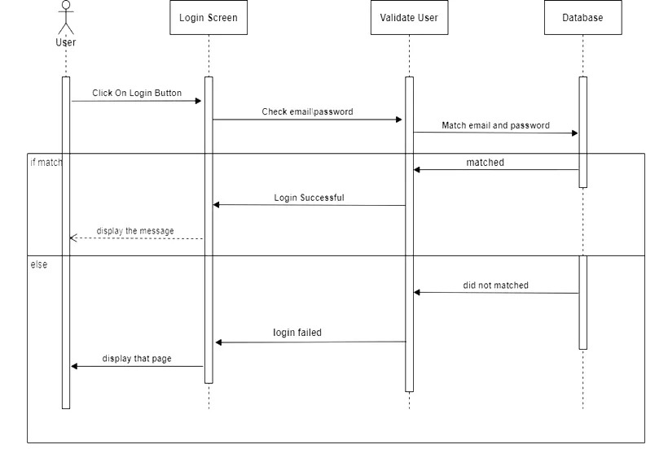

Slide 14
In Medicare, our Medicine Service is dedicated to delivering a diverse range of high-quality healthcare essentials. Admins have the power to curate our product catalog, keeping details such as product names, prices, sellers, and descriptions up-to-date. For users, our platform offers a seamless experience - from exploration and searching for products to applying filters and customizing selections. With our commitment to convenience and affordability, we strive to be your trusted source for healthcare essentials.
Medicine Service

Slide 15
Medicare's Order Service ensures a streamlined and hassle-free shopping experience. Users can create accounts, log in, and maintain their activity records. From searching and filtering products to customizing purchases, our platform empowers users every step of the way. With secure and seamless payment processing, users receive a detailed order summary once their payment is complete. We're committed to making healthcare essentials accessible and convenient for you.
Order Service

Slide 16
Medicare's Payment Service is your trusted partner for secure and efficient transactions. Users can complete their orders seamlessly with our robust payment processing system. We ensure a hassle-free payment experience, protecting your sensitive information. Whether it's for medicines or healthcare essentials, our Payment Service guarantees a smooth and secure transaction, providing peace of mind for our valued customers.
Payment Service

Slide 17
Spring Cloud Config Server
Purpose: Spring Cloud Config is a module that provides centralized externalized configuration management for microservices. It allows you to store configuration settings for multiple services in a central repository.
Use Case: It helps in maintaining configuration consistency across multiple microservices and allows for dynamic configuration changes without the need to redeploy services.

Slide 18
Spring Cloud Netflix Eureka
Purpose: Eureka is a service discovery and registration server. It allows microservices to register themselves and discover other services within a distributed system.
Use Case: Eureka simplifies the process of service registration and discovery, enabling dynamic scaling and load balancing of microservices.

Slide 19
Spring Cloud Open Feign
Purpose: Feign is a declarative web service client for making HTTP requests to other microservices. It allows developers to define API interfaces using annotations, making it easier to interact with RESTful services.
Use Case: Feign simplifies the consumption of RESTful services and can integrate seamlessly with other Spring Cloud components like Eureka for service discovery.

Slide 20
Spring Cloud Resilience4j
Purpose: Resilience4j is a lightweight fault tolerance library for Java. It helps developers implement resilience patterns such as circuit breakers, retries, rate limiting, and bulkheads in their microservices.
Use Case: Resilience4j helps ensure that microservices can gracefully handle failures and transient issues, improving system reliability.

Slide 21
Retry
Purpose: Retry is a component that can be used in conjunction with Resilience4j or independently. It provides mechanisms to retry failed operations, such as network requests or database queries.
Use Case: Retry is useful when dealing with operations that may fail temporarily due to external factors like network glitches.

Slide 22
Spring Cloud Sleuth
Purpose: Sleuth is a distributed tracing system for Spring Boot applications. It generates trace and span IDs for requests, allowing you to track requests as they traverse multiple microservices.
Use Case: Sleuth helps diagnose and troubleshoot issues in microservices architectures by providing insights into request flow and latency.

Slide 23
Spring Cloud ZipKin
Purpose: Zipkin is a distributed tracing system that works in conjunction with Sleuth. It collects and displays trace data, showing the path and timing of requests as they move through different microservices.
Use Case: Zipkin aids in identifying performance bottlenecks and latency issues within a distributed system.

Slide 24
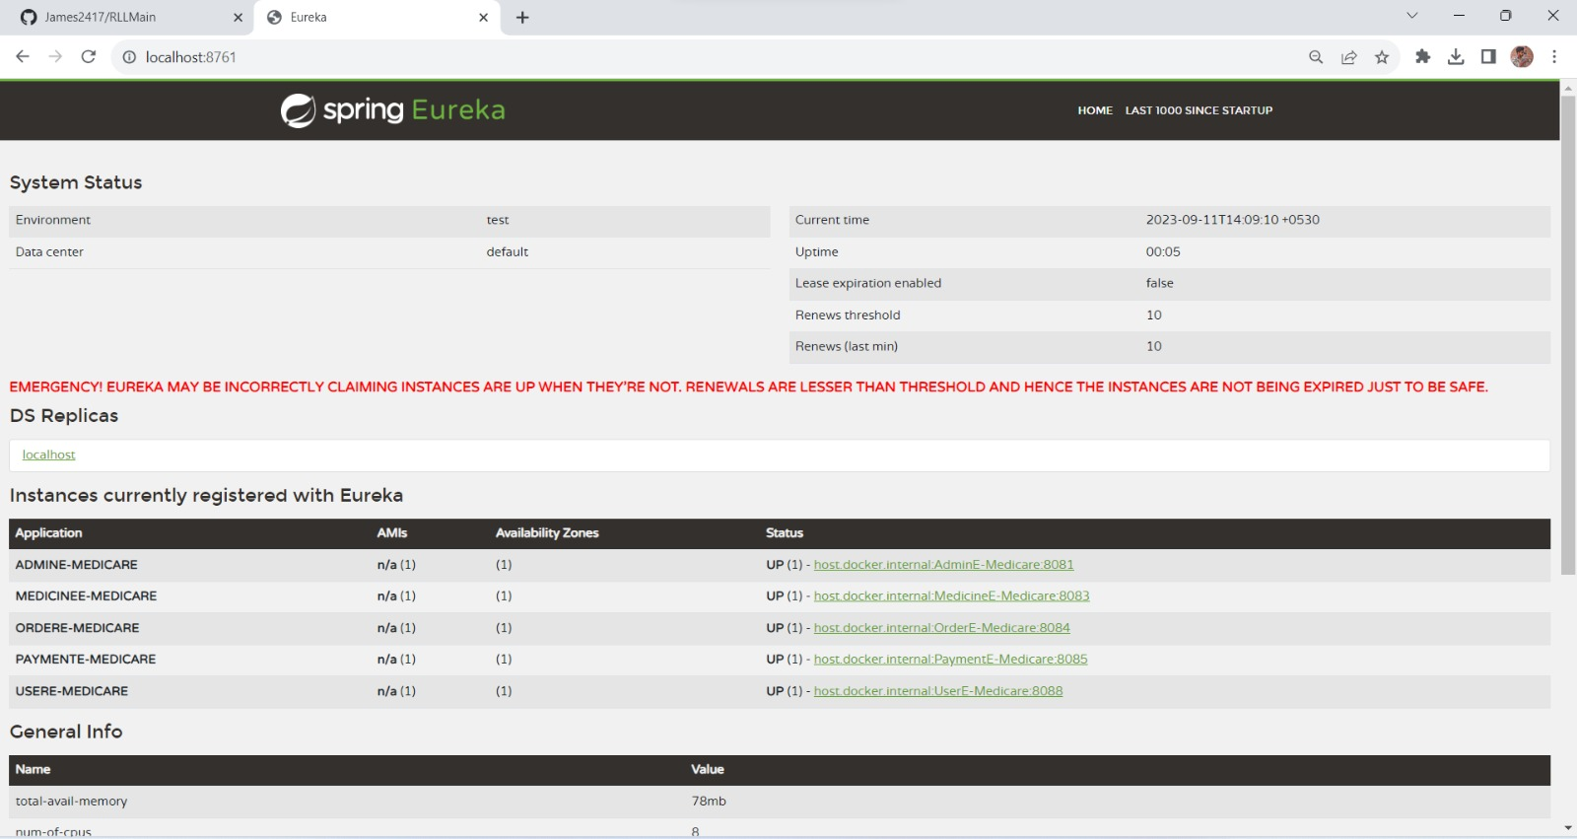
OUTPUT
EUREKA SERVER

Slide 25
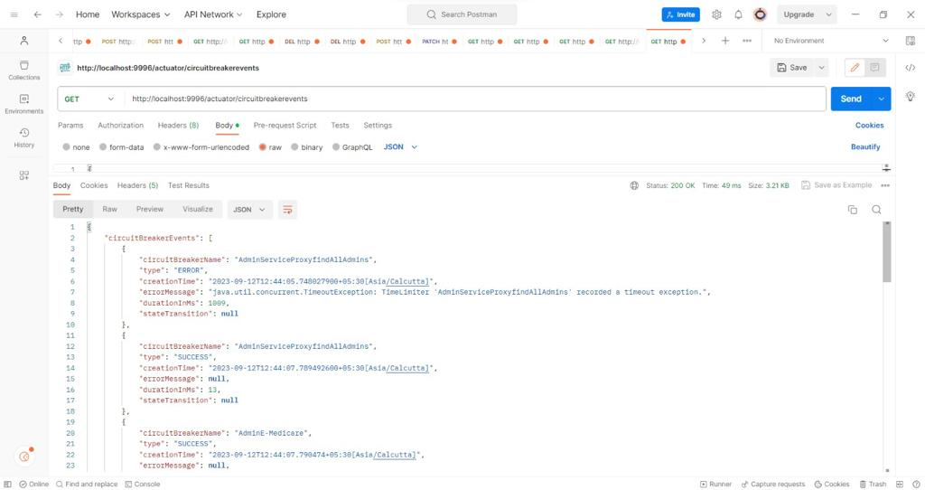
OUTPUT
CIRCUIT BREAKER

Slide 26
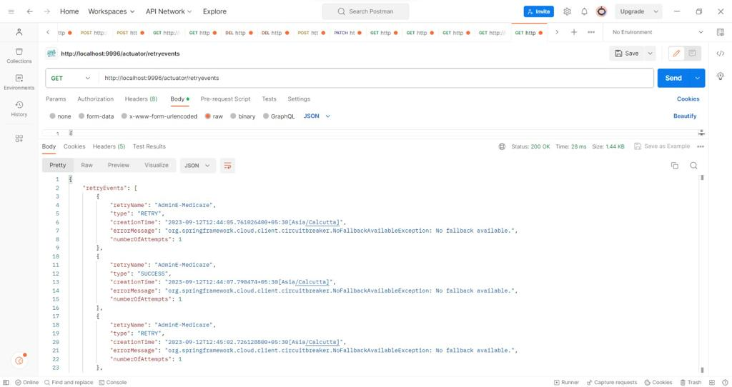
OUTPUT
RETRY

Slide 27
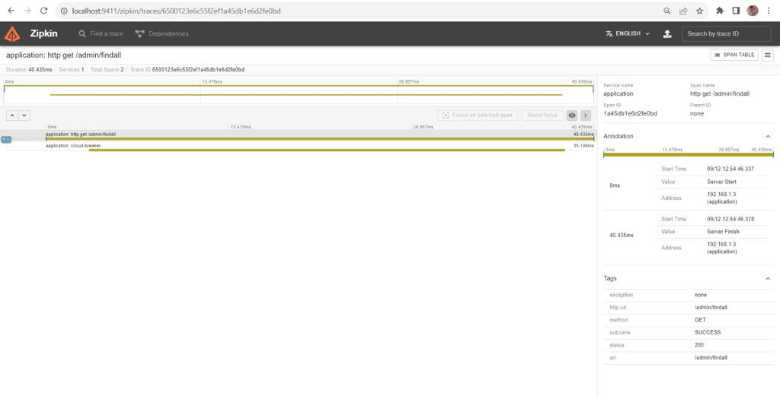
OUTPUT
ZIPKIN

Slide 28
Conclusion
The E-Medicare project has been a transformative endeavor, revolutionizing healthcare accessibility and delivery. We've achieved significant milestones, including user-friendly interfaces, secure payment processing, and robust communication channels.
Looking forward, E-Medicare is poised to continue reshaping the healthcare landscape by expanding services, forging more provider partnerships, and prioritizing patient-centric care. This project represents a commitment to enhancing healthcare for all

Slide 29


